Slide 1
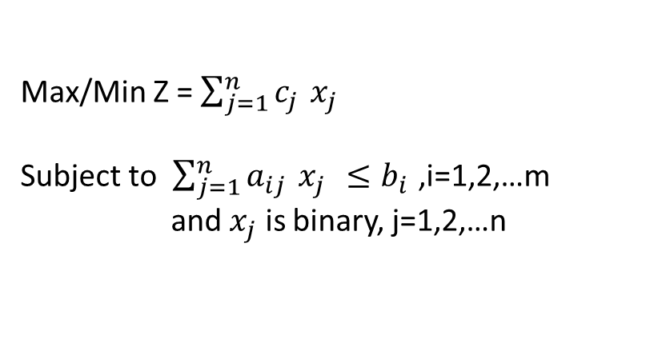
0-1 integer programming(0-1 IP)
Definition : 0-1 IP problems are linear problems where all the variables are binary variables
The mathematical model of 0-1 IP problem is as follows:
Max/Min Z = $\sum_{j=1}^{n}{c_{j }}x_{j}$
Subject to $\sum_{j=1}^{n}{a_{ij }}x_{j }≤b_{i }$,i=1,2,…m
and $x_{j}$ is binary, j=1,2,…n
Remark :Before we apply the algorithm to solve a 0-1 IP problem, we need to make sure that the coefficients of the objective function are integers.

Slide 2
Example : A knapsack problem
We want to put four items in a knapsack that can hold up to 12 kg. The weight and the value associated to each of the items:
Item 1 2 3 4
Weight (kg) 3 6 5 5
Value (Rs) 15 25 12 10
We need to decide which items to put in so as to maximize the total value of the knapsack.
We define four binary variables, one for each item j, j = 1, 2, 3, 4:
x_{j} = {1 if item j is introduced in the knapsack
0, Otherwise
The 0-1 IP model that represents the problem is:
max z = 15x1 +25x2 +12x3 +10x4
subject to
3x1 +6x2 +5x3 +5x4 ≤ 12
x1, x2, x3, x4 = 0 or 1

Slide 3
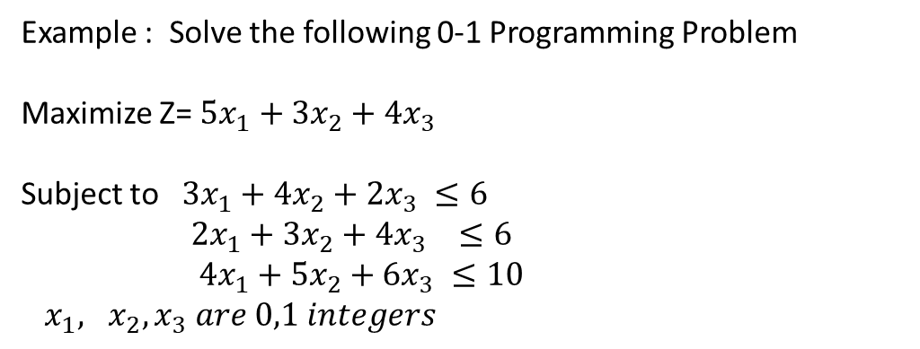
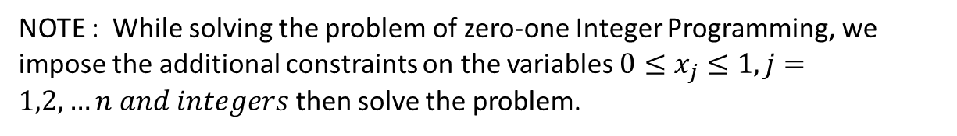
NOTE : While solving the problem of zero-one Integer Programming, we impose the additional constraints on the variables $0≤x_{j}≤1, j=1,2,…n and integers$ then solve the problem.
Example : Solve the following 0-1 Programming Problem
Maximize Z= $5x_{1}+3x_{2}+4x_{3}$
Subject to $3x_{1}+4x_{2}+2x_{3} ≤6$
$2x_{1}+3x_{2}+4x_{3} ≤6$
$4x_{1}+5x_{2}+6x_{3} ≤10$
$x_{1}, x_{2}, x_{3} are 0,1 integers$

Slide 4
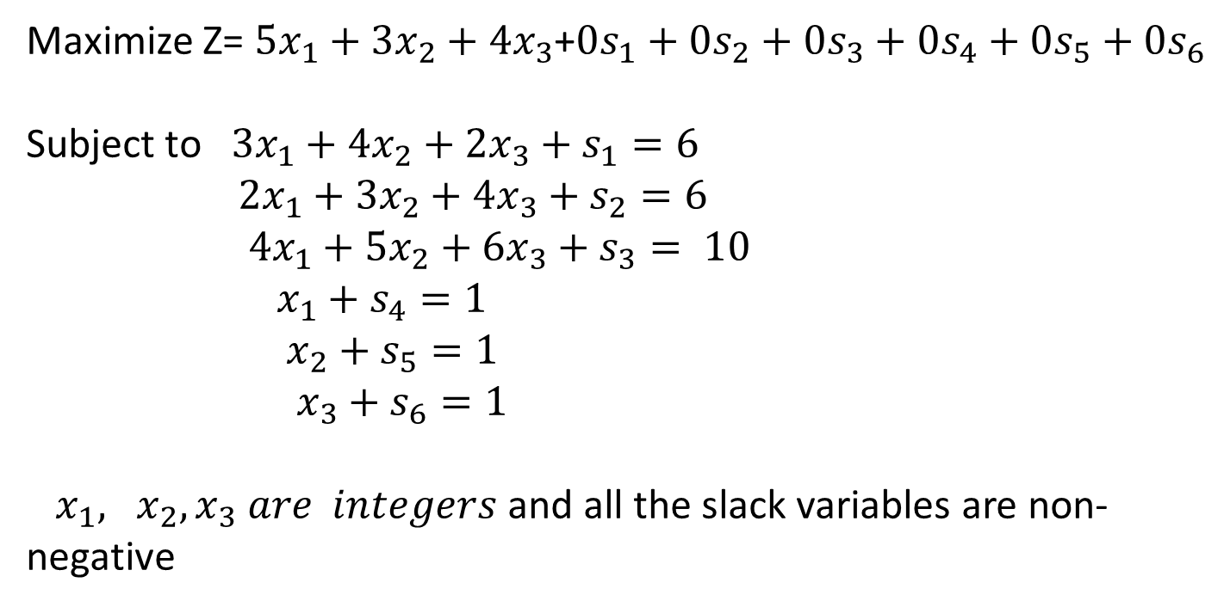
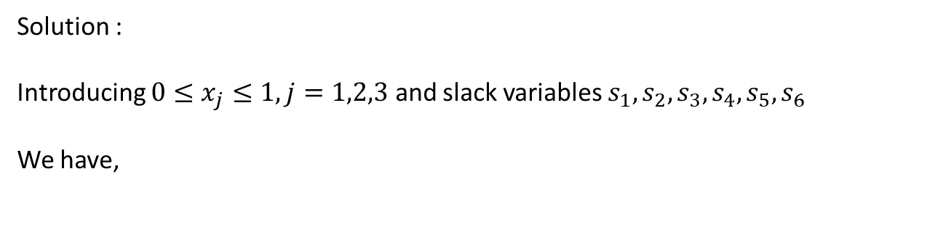
Solution :
Introducing $0≤x_{j}≤1, j=1,2,3$ and slack variables $s_{1}, s_{2}, s_{3},s_{4},s_{5}, s_{6}$
We have,
Maximize Z= $5x_{1}+3x_{2}+4x_{3}$+$0s_{1}+0s_{2}+0s_{3}+0s_{4}+0s_{5}+0s_{6}$
Subject to $3x_{1}+4x_{2}+2x_{3}+s_{1}=6$
$2x_{1}+3x_{2}+4x_{3}+s_{2}=6$
$4x_{1}+5x_{2}+6x_{3}+s_{3}= 10$
$x_{1}+s_{4}=1$
$x_{2}+s_{5}=1$
$x_{3}+s_{6}=1$
$x_{1}, x_{2}, x_{3} are integers$ and all the slack variables are non-negative

Slide 5
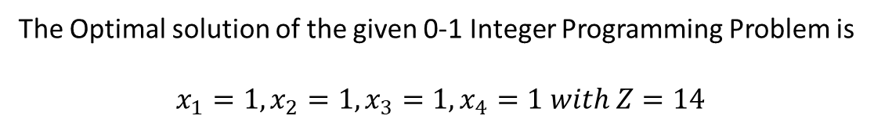
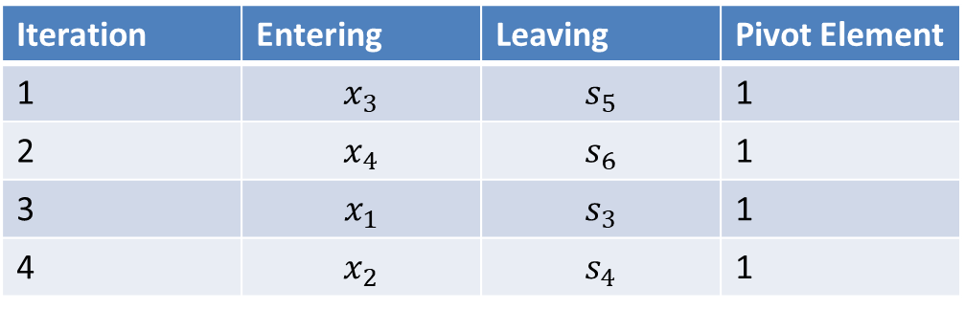
Iteration | Entering | Leaving | Pivot Element
1 | $$x_{3}$$ | $$s_{5}$$ | 1
2 | $$x_{4}$$ | $$s_{6}$$ | 1
3 | $$x_{1}$$ | $$s_{3}$$ | 1
4 | $$x_{2}$$ | $$s_{4}$$ | 1
The Optimal solution of the given 0-1 Integer Programming Problem is
$$x_{1}=1, x_{2}=1, x_{3}=1, x_{4}=1 with Z=14$$

Slide 6
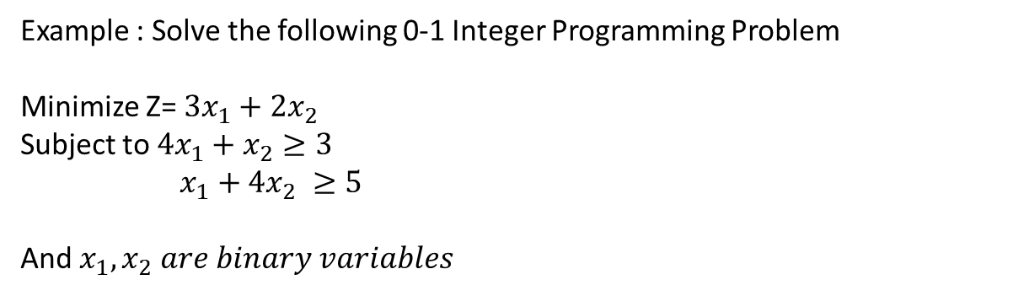
Example : Solve the following 0-1 Integer Programming Problem
Minimize Z= $3x_{1}+2x_{2}$
Subject to $4x_{1}+x_{2}≥3$
$x_{1}+4x_{2} ≥5$
And $x_{1},x_{2} are binary variables$

Slide 7
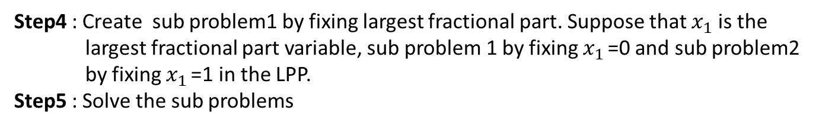
Branch and Bound Method for 0-1 Integer Programming Problem
Step1: Replace the Binary variable $x_{j}$ by 0$≤x_{j }≤1 and x_{j }is integer$
Step2: Ignore the integer conditions, solve the resultant LPP
Step3: If all the variables value in the Optimal solution of LPP are integer, the optimal
solution of 0-1 IP is the Optimal solution of LPP. Otherwise, go to next Step.
Step4 : Create sub problem1 by fixing largest fractional part. Suppose that $x_{1}$is the
largest fractional part variable, sub problem 1 by fixing $x_{1 }$=0 and sub problem2
by fixing $x_{1 }$=1 in the LPP.
Step5 : Solve the sub problems
Step6: Examine the optimal solutions of the sub problems
If a sub problem optimal solution has either integer solution or Infeasible or the
the objective function value is less than the objective function value of LPP, it is
fathomed and Stop when there are no remaining fathomed sub problems.
Otherwise, Go to next step
Step7: Create two new sub problems by fixing the next variable at either 0 or 1 from the
Sub problem which has the non integer solution with highest objective function
value and go to Step 5

Slide 8

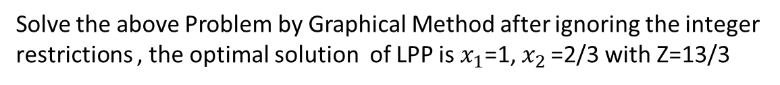
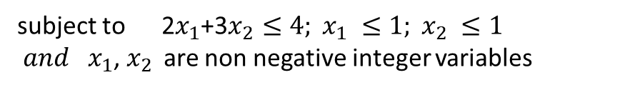

Example 1: Solve the following 0-1 Integer Programming Problem:
Maximize Z= 3$x_{1 }$+2$x_{2}$
subject to 2$x_{1}$+3$x_{2}≤4 and x_{1}$, $x_{2 }$ are binary variables
Solution :
Step1 :
Maximize Z= 3$x_{1 }$+2$x_{2}$
subject to 2$x_{1}$+3$x_{2}≤4; x_{1} ≤1; x_{2} ≤1$
$and { x}_{1}$, $x_{2 }$ are non negative integer variables
Step2:
Solve the above Problem by Graphical Method after ignoring the integer restrictions , the optimal solution of LPP is $x_{1}$=1, $x_{2 }$=2/3 with Z=13/3

Slide 9


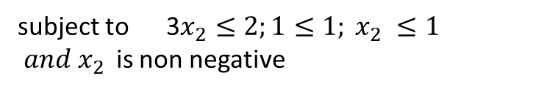

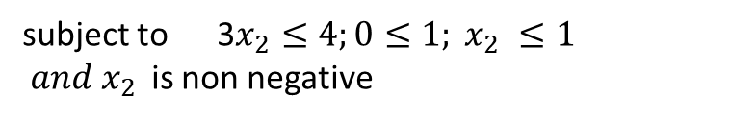
Step3: The Optimal solution of LPP is not integers
Step4&5: Create sub problem 1 by Fixing $x_{1 }$=0 and sub problem 2 by fixing $x_{1 }$=1
in the LPP
Sub problem1:
Maximize Z= 2$x_{2}$
subject to 3$x_{2}≤4;0≤1; x_{2} ≤1$
$and x_{2 }$ is non negative
Optimal solution : Infeasible
Sub problem2:
Maximize Z= 3+2$x_{2}$
subject to 3$x_{2}≤2;1≤1; x_{2} ≤1$
$and x_{2 }$ is non negative
Optimal solution: $x_{2 }$=2/3 with Z=13/3

Slide 10

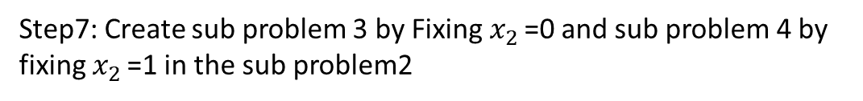
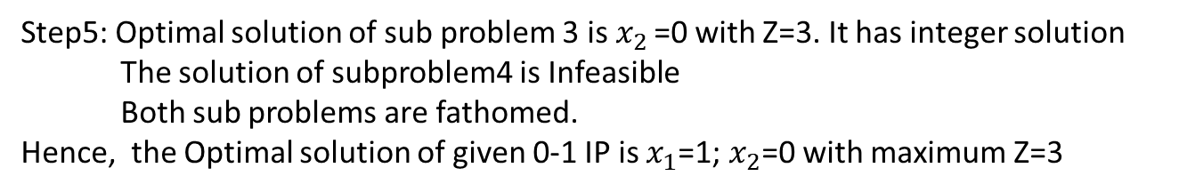

Step6:
The sub problem1 is fathomed
The Optimal solution of sub problem2 is not integer
Step7: Create sub problem 3 by Fixing $x_{2 }$=0 and sub problem 4 by fixing $x_{2 }$=1 in the sub problem2
Sub problem3:
Max Z=3 Subject to 0$≤2;1≤1;0≥0$
Sub problem4:
Max Z=5 Subject to 3$≤2;1≤1;1≥0$
Step5: Optimal solution of sub problem 3 is $x_{2 }$=0 with Z=3. It has integer solution
The solution of subproblem4 is Infeasible
Both sub problems are fathomed.
Hence, the Optimal solution of given 0-1 IP is $x_{1}$=1; $x_{2}$=0 with maximum Z=3

Slide 11
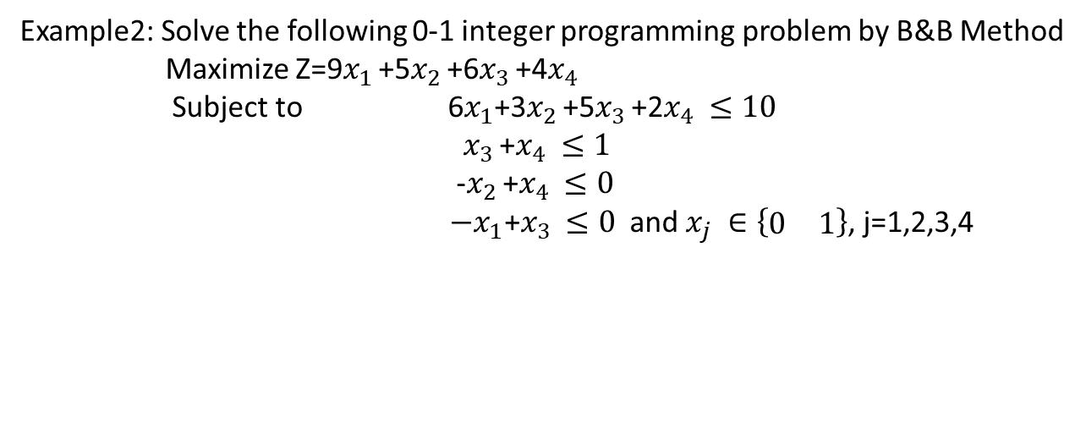
Example2: Solve the following 0-1 integer programming problem by B&B Method
Maximize Z=9$x_{1 }$+5$x_{2 }$+6$x_{3 }$+4$x_{4 }$
Subject to 6$x_{1}$+3$x_{2 }$+5$x_{3 }$+2$x_{4 }≤10$
$x_{3 }$+$x_{4 }≤1$
-$x_{2 }$+$x_{4 }≤0$
$−x_{1}\text{+}x_{3 }≤0$ and $x_{j} ∈\left\{\begin{matrix}0 & 1\end{matrix}\right\}$, j=1,2,3,4
LPP Optimal Solution is $\left(x_{1 },x_{2}, x_{3}, x_{4}\right)$=$\left(\frac{5}{6},1,0,1\right)$ with Z=16 1/2

Slide 12
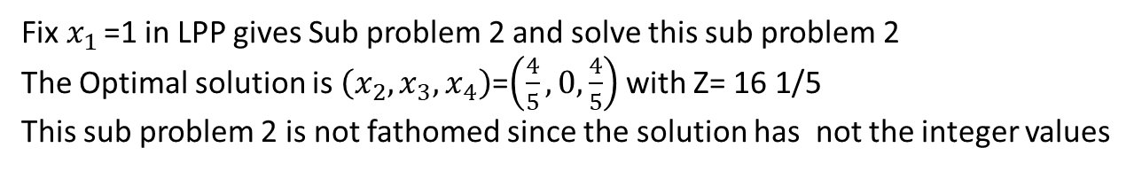
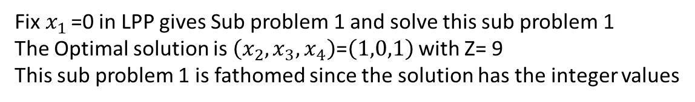
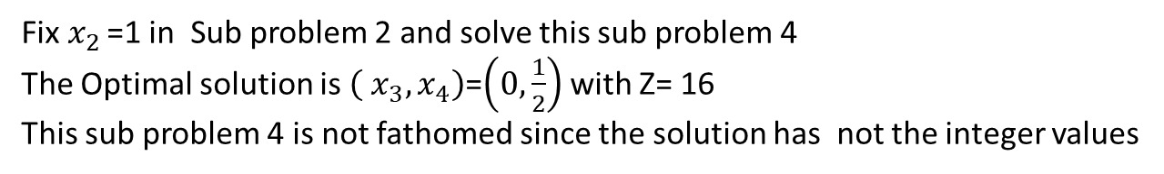
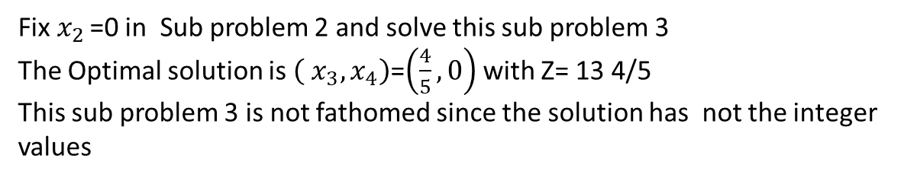
Fix $x_{1 }$=0 in LPP gives Sub problem 1 and solve this sub problem 1
The Optimal solution is $\left(x_{2}, x_{3}, x_{4}\right)$=$\left(1,0,1\right)$ with Z= 9
This sub problem 1 is fathomed since the solution has the integer values
Fix $x_{1 }$=1 in LPP gives Sub problem 2 and solve this sub problem 2
The Optimal solution is $\left(x_{2}, x_{3}, x_{4}\right)$=$\left(\frac{4}{5}, 0, \frac{4}{5}\right)$ with Z= 16 1/5
This sub problem 2 is not fathomed since the solution has not the integer values
Fix $x_{2 }$=0 in Sub problem 2 and solve this sub problem 3
The Optimal solution is $\left( x_{3}, x_{4}\right)$=$\left(\frac{4}{5}, 0\right)$ with Z= 13 4/5
This sub problem 3 is not fathomed since the solution has not the integer values
Fix $x_{2 }$=1 in Sub problem 2 and solve this sub problem 4
The Optimal solution is $\left( x_{3}, x_{4}\right)$=$\left(0, \frac{1}{2}\right)$ with Z= 16
This sub problem 4 is not fathomed since the solution has not the integer values

Slide 13
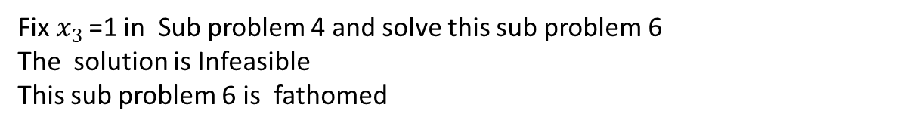
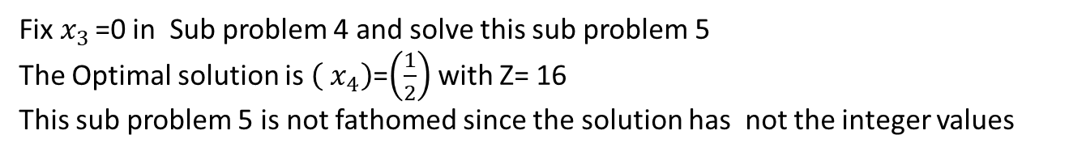
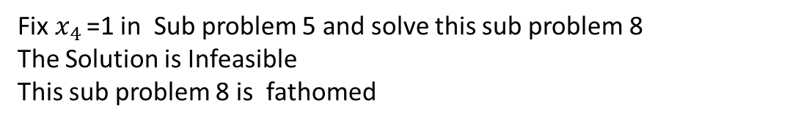
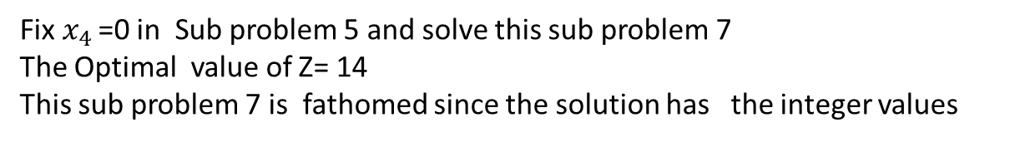
Since the objective function value of sub problem 4 is larger than that of sub problem3,
Fix $x_{3 }$=0 in Sub problem 4 and solve this sub problem 5
The Optimal solution is $\left( x_{4}\right)$=$\left(\frac{1}{2}\right)$ with Z= 16
This sub problem 5 is not fathomed since the solution has not the integer values
Fix $x_{3 }$=1 in Sub problem 4 and solve this sub problem 6
The solution is Infeasible
This sub problem 6 is fathomed
Fix $x_{4 }$=0 in Sub problem 5 and solve this sub problem 7
The Optimal value of Z= 14
This sub problem 7 is fathomed since the solution has the integer values
Fix $x_{4 }$=1 in Sub problem 5 and solve this sub problem 8
The Solution is Infeasible
This sub problem 8 is fathomed
Since there are no remaining unfathomed sub problems, the Optimal solution of the
Given 0-1 Integer Programming Problem is $\left(x_{1 },x_{2}, x_{3}, x_{4}\right)$=$\left(1,1,0,0\right)$ with Z=14

